Slide 1

The Skin
GTHBY Human Biology

Slide 2
Review
Human Eye | Vision Direct UK

Slide 3
Review
3. What type of neuron would you find in the retina?
4. Draw a picture of this type of neuron.
5. Which part of the brain would the nerve signals from the eye go to? Why?

Slide 4
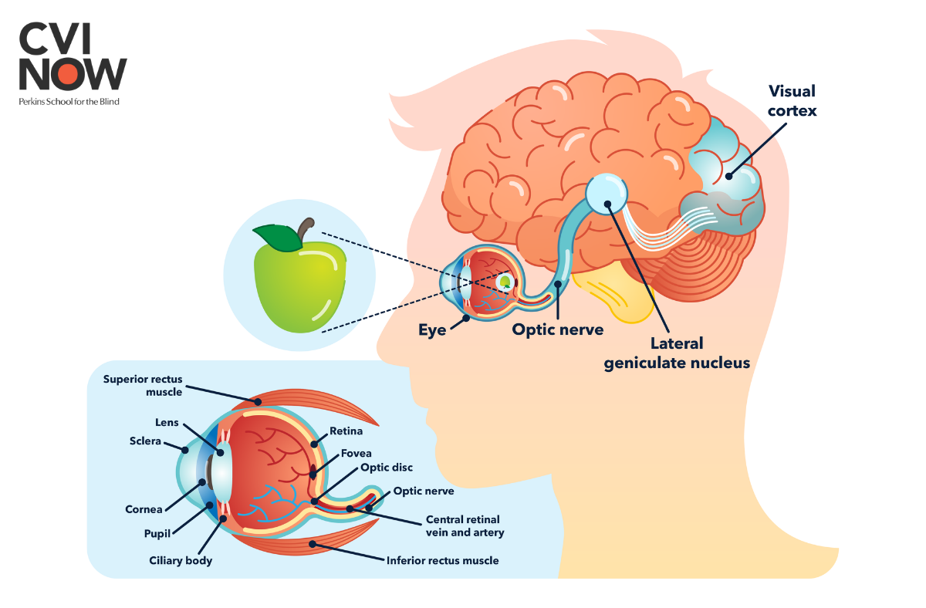

Slide 5
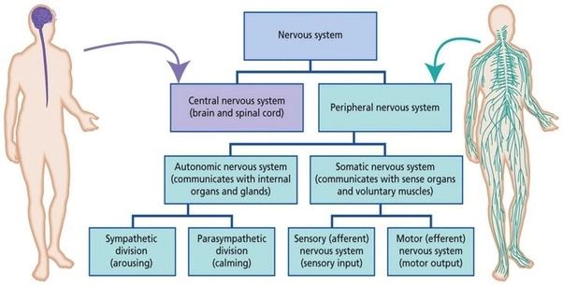

Slide 6
Learning Intentions
Structure of the skin and the stimuli it responds to

Slide 7
Success Criteria
Label an anatomical diagram of an skin
Explain that the skin is not a specialised sensory organ, but that it contains sensory nerve endings that respond to a variety of stimuli
List stimuli that the skin can detect

Slide 8

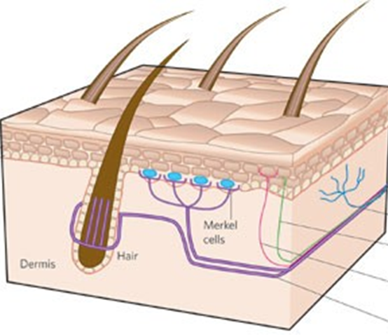
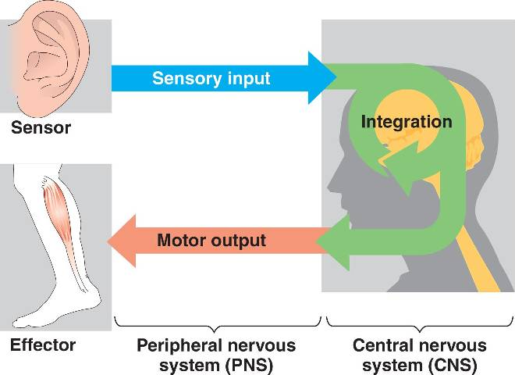
Primary Functions
Sensory (afferent) neurons
Interneurons
Motor (efferent) neurons

Slide 9
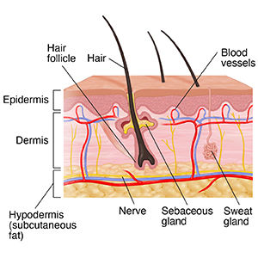

Slide 10
Skin as a receptor
While some receptors are specialised to respond to a specific stimulus, eg eyes to light and ears to sound, the skin is a more generalised receptor. It contains free nerve endings that respond to different stimuli, such as pain, touch (light or pressure), stretch, heat or cold and vibration.

Slide 11
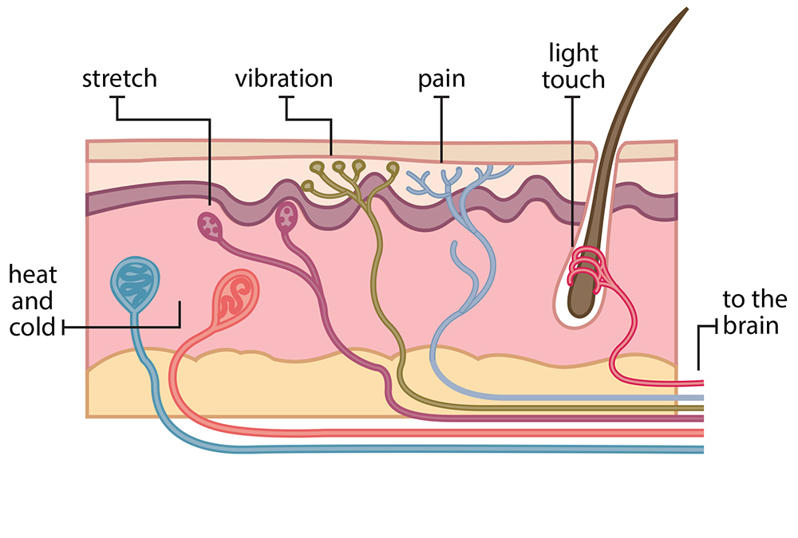

Slide 12
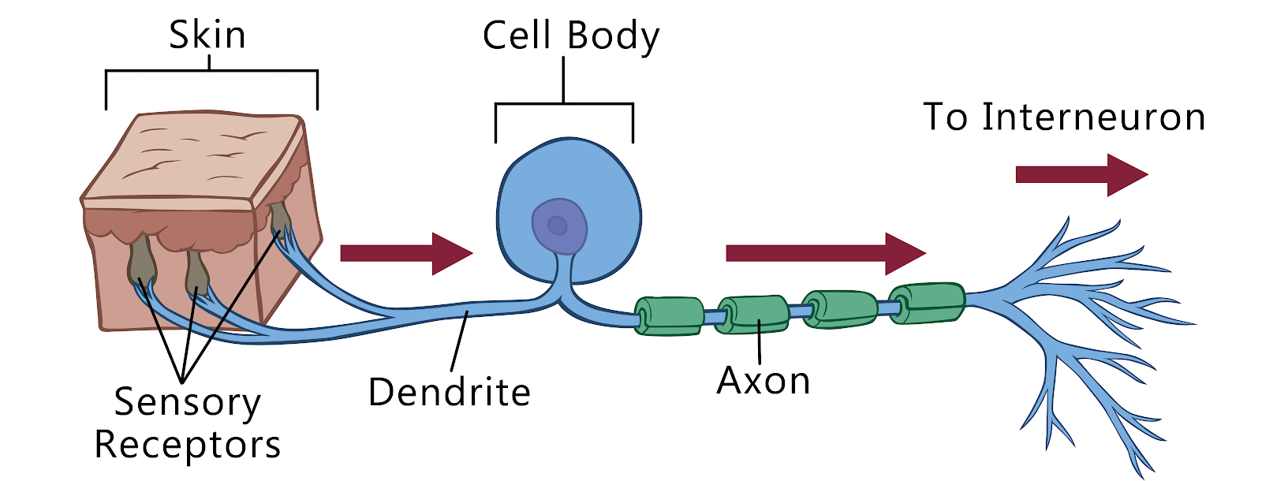
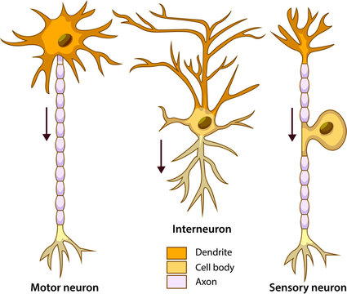
Skin to brain pathways
Sensory neurons Interneurons (Parietal Lobe)

Slide 13
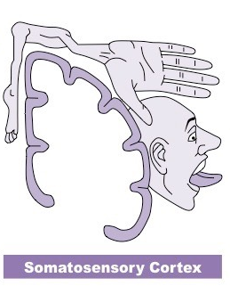
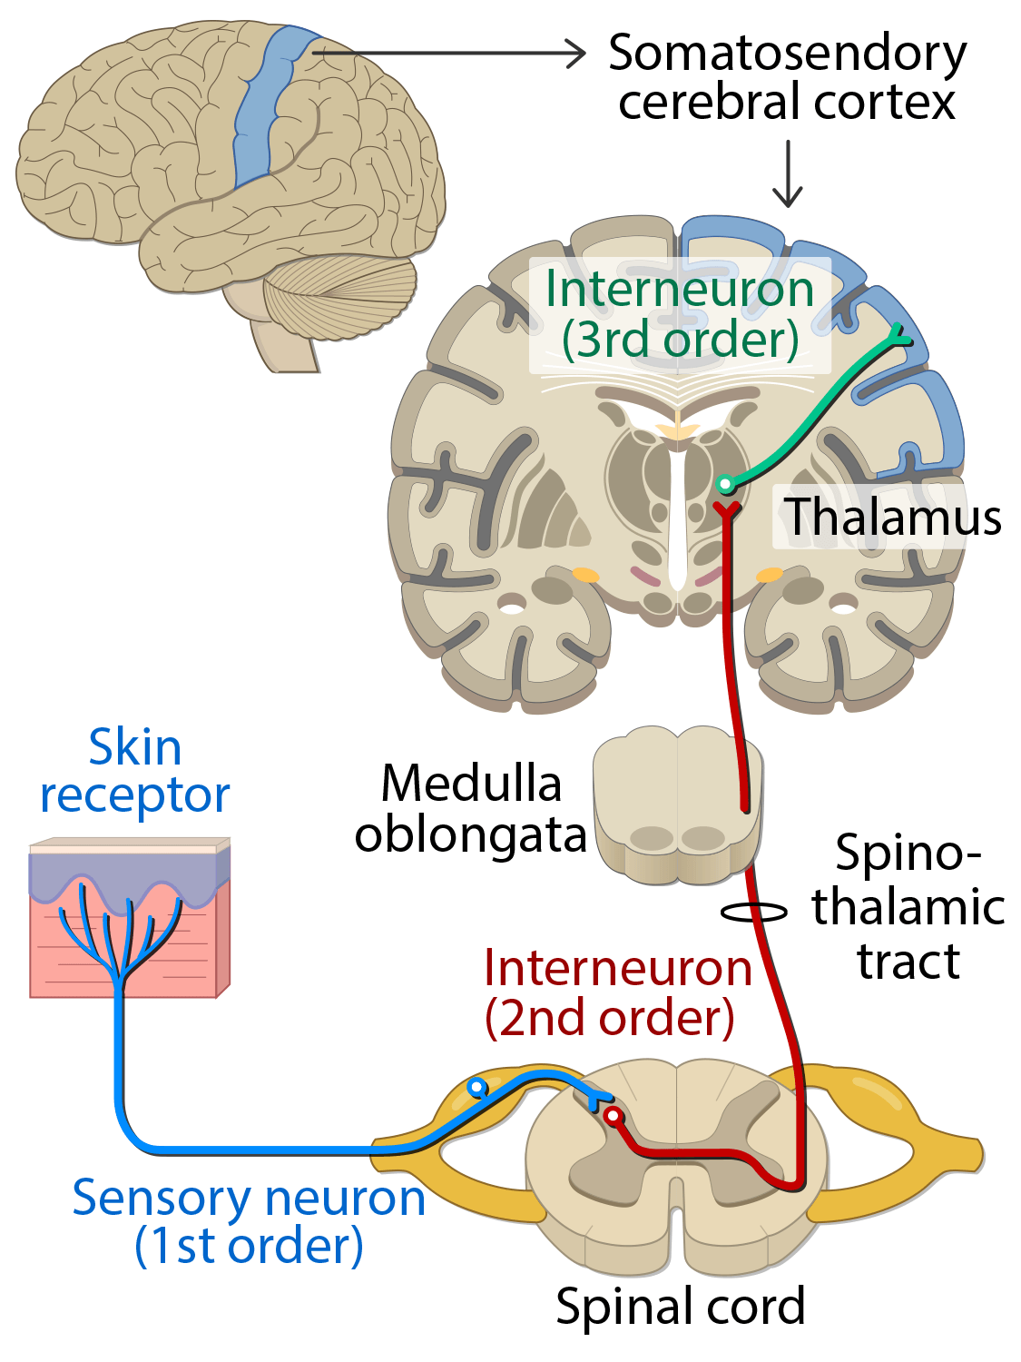

Slide 14
Success Criteria
Label an anatomical diagram of an skin
Explain that the skin is not a specialised sensory organ, but that it contains sensory nerve endings that respond to a variety of stimuli
List stimuli that the skin can detect

